Slide 1

15CSE301 Computer Organization and Architecture
Lecture 1
Course Introduction
Dr Ganesh Neelakanta Iyer
Associate Professor, Dept of Computer Science and Engg
Amrita Vishwa Vidyapeetham, Coimbatore

Slide 2






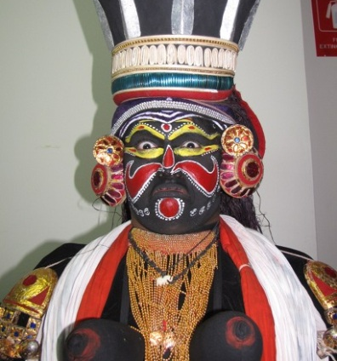
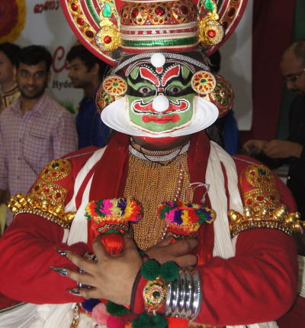
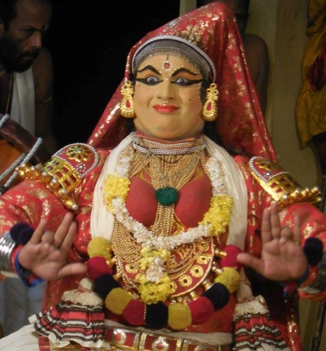
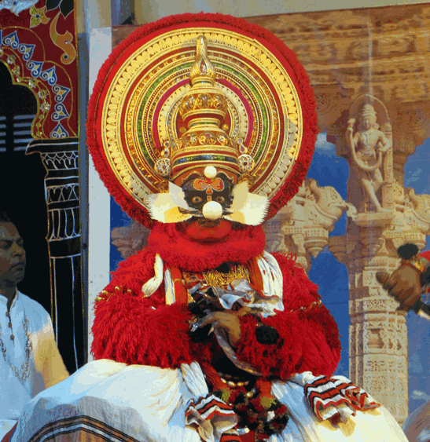
About Me
Associate Professor, Amrita Vishwa Vidyapeetham
Masters & PhD from National University of Singapore (NUS)
Several years in Industry/Academia
Architect, Manager, Technology Evangelist, Visiting Faculty
Talks/workshops in USA, Europe, Australia, Asia
Cloud/Edge Computing, IoT, Software Engineering, Game Theory, Machine Learning
Kathakali Artist, Composer, Speaker, Traveler, Photographer
GANESHNIYER
http://ganeshniyer.com

Slide 3
Outline of the course
This course aims at introducing the concept of computer architecture and organization
It involves design aspects, and deals with the current trends in computing architecture
System resources such as memory technology and I/O subsystems needed to achieve proportional increase in performance will also be discussed

Slide 4
Mode of delivery
15CSE301 – Theory course
15CSE381 COA Lab

Slide 5
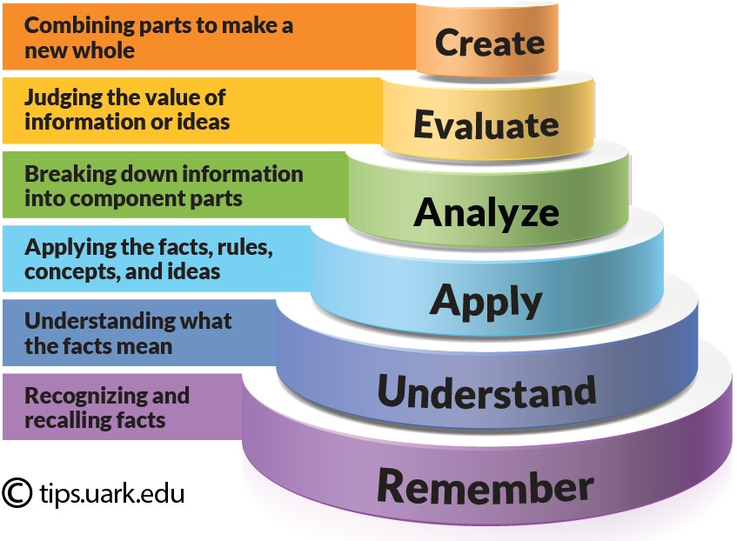
Course outcomes
CO No | Course Outcome Description | BTL
CO 1 | Understand the design principles of Instruction Set Architecture (ISA) by taking MIPS as reference. | L3
CO 2 | Design, Implementation and Analysis of datapath for instruction execution using Single Clock Cycle | L4
CO 3 | Understand design of instruction execution using Multiple Clock Cycles and Analyze / Evaluate the performance of processors. | L5
CO 4 | Understand Pipelined architecture and Design of 3 and 5 stage pipeline processor in MIPS | L5
CO 5 | Understand the working of Arithmetic and Logic Unit | L3
CO 6 | Understanding the concepts of Memory Organization. | L3

Slide 6
Pre-requisites
Need to
Remember concepts learnt in Digital Circuits
Remember concepts learnt in Embedded Systems

Slide 7
Tentative Syllabus Outline
Introduction of Computing system
Processor Architecture with example as MIPS & Instruction Set
Single Cycle Datapath Design
Introduction to multicycle at a path
Performance of Computing system, Role of performance
Pipelining Technique
Design Issues
Hazards: Structural Hazards, Data Hazards and Control Hazards (Static Branch Prediction, Dynamic Branch Prediction)
Memory Organization
Introduction, Cache Memory Organization
Computer Arithmetic
Binary multiplication and Division
Floating Point Arithmetic

Slide 8
COA Theory - Text Book
Patterson, David A & J L Hennessy, Computer Organization & Design, The Hardware/Software interface Morgan Kaufmann, 3rd Ed., 2010.

Slide 9
Evaluation Pattern for 15CSE301
Evaluation mechanism | Weightage
Periodical 1 | 15%
Periodical 2 | 15%
Continuous Evaluation (Quiz and Tutorials) | 20%
End-semester examination | 50%

Slide 10
15CSE381 – COA Lab
In Digital Circuits and Systems, you learnt working with hardware design
Design and experiment using real hardware is fun and exciting but at times it is expensive and time consuming
Here, you will learn how hardware design can be simulated using software
Design is easier
No fear of hardware damage
Less Expensive

Slide 11
15CSE381 – COA Lab
Verilog HDL is a hardware description language used to design and document electronic systems
Verilog HDL allows designers to design at various levels of abstraction
Applied to electronic design, Verilog is intended to be used for verification through simulation, for timing analysis, for test analysis (testability analysis and fault grading) and for logic synthesis.

Slide 12
15CSE381 – COA Lab
Icarus Verilog is a free compiler implementation for the IEEE-1364 Verilog hardware description language
http://bleyer.org/icarus/
We will use this to simulate hardware design in our lab
/* A simple and gate
File: 1_and.v */
module andgate (a, b, y);
input a, b;
output y;
// using data flow abstraction
assign y = a & b;
//using gate level abstraction
//and a1(y,a,b);
//run either gate level or data flow level code
endmodule

Slide 13
Evaluation pattern for Lab
80% CA (P1, P2, Lab evaluations, Case study)
20% End Sem

Slide 14
Time and Location
Classes
Monday 1210-1300 @ A104
Tuesday 0930-1020 @ A203
Friday 1350-1440 @ A104
Lab
Friday 0840-1110 @ ABII, CPLab4
Office Hours
Monday 1120-1210 @ My office (GF 3rd Office room)

Slide 15
Mode of communication
Lets have a COA Whatssap group for all COA communication
Any course matter you wish to discuss with me, please use office hours unless the matter is very urgent
Office Hours
Monday 1120-1210 @ My office (GF 3rd Office room)

Slide 16
Points to follow
Maintain two note books
One for theory notes – Lots of problems to be worked out in the class and note book is essential
One for Lab observation
You may wish to write lab matters in the book directly or write them on a word document, print it and paste it in the book
Keep a copy of the text book handy (e-copy is sufficient) and ensure you read the text book well

Slide 17
Office Hours
Monday 1120-1210 @ My office

